Slide 1


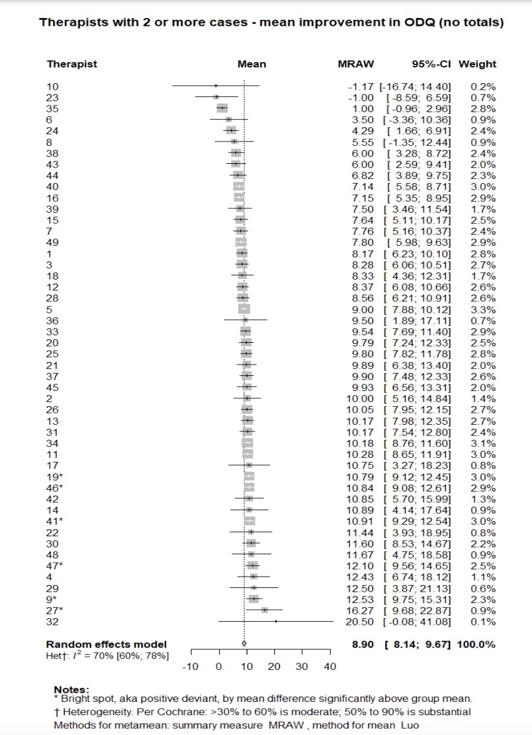
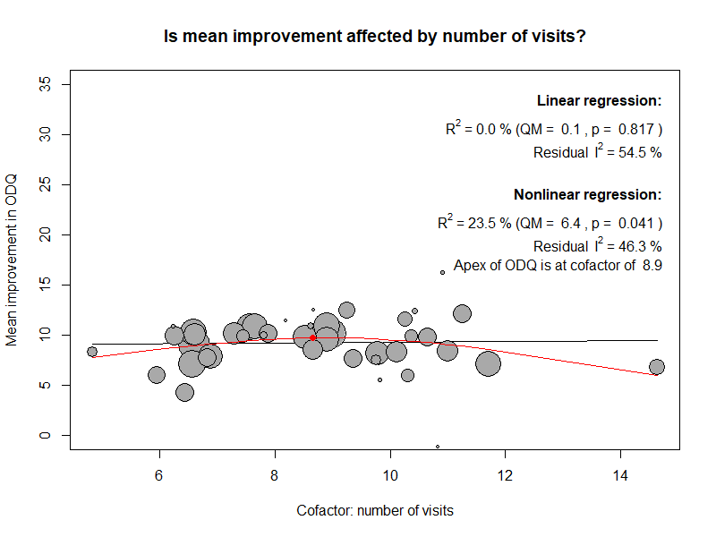
Ashina K. Rana, MD¹; Robert G. Badgett, MD¹; Michael Reynolds, OTR; Robert C. Manske, PT, DPT, MEd Kansas University School of Medicine – Wichita Wichita State University
Outcome Variation in Physical Therapists: Implication for Positive Deviance to Share Tacit Expertise
Objectives
Methods
Assess the appropriateness of a positive deviance approach to shared learning of expertise
Measuring the heterogeneity in physical therapy outcomes across therapists causing the positive deviance.
Retrospective cohort study
Outpatient cases at Ascension Via Christi Therapy with a diagnosis of lumbar back pain, between March 2012 and March 2023 were studied.
Therapists with at least 5 cases were included.
Random effect analysis
Random effect analysis was used to assess the heterogeneity in the Oswestry Back Pain Disability Questionnaire (ODQ), across therapists.
Meta-regression
Meta-regression assessed the influence of therapists’ experience (number of cases), and approach (average number of visits), and patient factors (average entry ODQ and age per therapist).
Spline regression analysis
Spline analyses looks for non-linear relations between the theraptis tactgds, patient characteristics and ODQ outcomes.
Introduction
Back pain is a common problem in primary care settings.
Therapists' effectiveness varies based on their tacit knowledge and skills, as well as their choice of tactics.
Positive deviance can be a means of shared learning to improve outcomes.
Results
1329 patients with a mean age of 57.5 years and entry ODQ score of 18.9 were treated by 42 therapists.
After an average of 8 visits, the mean ODQ score was 9.5.
Heterogeneity across therapists was moderate (I² = 52%).
Nonlinear meta-regressions show significant effects of the average patient age, entry ODQ, and the number of visits of the therapists with the most benefit occurring in patients 56 years old with an ODQ of 23 and at 9 visits.
.
Aims of our study
The long-term goal is to use PD to improve the impact of physical therapy
The current goal is to assess the appropriateness of a positive deviance approach by measuring the heterogeneity in outcomes of physical therapy across providers in a single clinical site.
The central hypothesis is that when treating patients with low back pain, therapists will have significant heterogeneity in rates of positive outcomes.
Discussion
References
The significant heterogeneity supports the role of positive deviance as a method of shared learning to improve the group’s outcomes.
The meta regressions suggest topics that shared learning should address to improve physical therapy outcomes.
References
Chapman JR, Norvell DC, Hermsmeyer JT, Bransford RJ, DeVine J, McGirt MJ, Lee MJ. Evaluating common outcomes for measuring treatment success for chronic low back pain. Spine. 2011 PMID: 21952190
Freburger JK, Carey TS, Holmes GM. Physical therapy for chronic low back pain in North Carolina: overuse, underuse, or misuse? Phys Ther. 2011 PMID: 21330449
Can positive deviance in physical therapy outcomes be a means of shared learning to improve groups' outcomes?

Slide 2
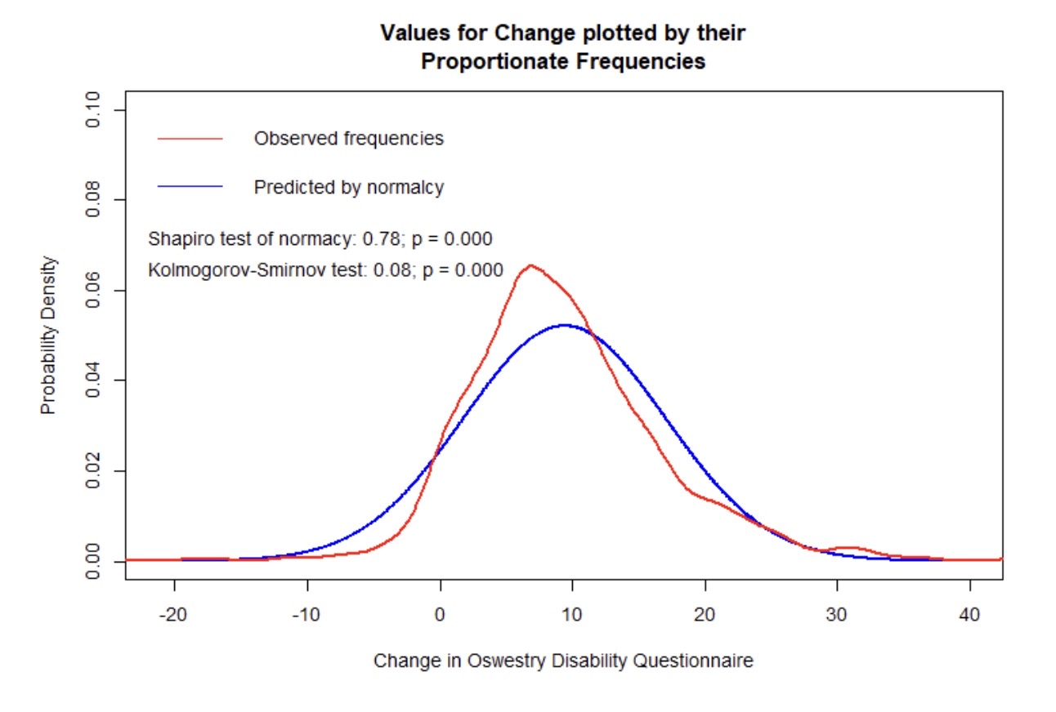
Outcome Variation in Physical Therapists: Implication for Positive Deviance to Share Tacit Expertise Ashina K. Rana, MD¹; Robert G. Badgett, MD¹; Michael Reynolds, OTR; Robert C. Manske, PT, DPT, MEd Kansas University School of Medicine – Wichita Wichita State University
Objectives
Assess the appropriateness of a positive deviance approach to shared learning of expertise
Measuring the heterogeneity in physical therapy outcomes across therapists causing the positive deviance.
Methods
Retrospective cohort study
Outpatient cases at Ascension Via Christi Therapy with a diagnosis of lumbar back pain, between March 2012 and March 2023 were studied.
Therapists with at least 5 cases were included.
Random effect analysis
Random effect analysis was used to assess the heterogeneity in the Oswestry Back Pain Disability Questionnaire (ODQ), across therapists.
Meta-regression
Meta-regression assessed the influence of therapists’ experience (number of cases), and approach (average number of visits), and patient factors (average entry ODQ and age per therapist).
Spline regression analysis
Spline analyses looks for non-linear relations between the theraptis tactgds, patient characteristics and ODQ outcomes.
Introduction
Back pain is a common problem in primary care settings.
Therapists' effectiveness varies based on their tacit knowledge and skills, as well as their choice of tactics.
Positive deviance can be a means of shared learning to improve outcomes
Can positive deviance in physical therapy outcomes be a means of shared learning to improve groups' outcomes
Results
1329 patients with a mean age of 57.5 years and entry ODQ score of 18.9 were treated by 42 therapists.
After an average of 8 visits, the mean ODQ score was 9.5.
Heterogeneity across therapists was moderate (I² = 52%).
Nonlinear meta-regressions show significant effects of the average patient age, entry ODQ, and the number of visits of the therapists with the most benefit occurring in patients 56 years old with an ODQ of 23 and at 9 visits
.
Discussion
The significant heterogeneity supports the role of positive deviance as a method of shared learning to improve the group’s outcomes.
The meta regressions suggest topics that shared learning should address to improve physical therapy outcomes.
References
References can be found online

